Slide 1

WORLDWIDE DEVELOPERS CONFERENCE 2026
The Keynote, Decoded
A new Siri, Apple Intelligence everywhere, and six new operating systems — what Apple announced today and when it actually ships.
Silicon Mountain Mac Users Group
General Meeting · Monday, June 8, 2026

Slide 2






TONIGHT'S AGENDA
What we'll cover
Siri AI
Apple Intelligence
iOS & iPadOS 27
Rebuilt on Google Gemini
New generative features
Design + everyday features
macOS Golden Gate
TV · Watch · Vision
Ship dates & analysts
The Mac's turn for AI
tvOS, watchOS & visionOS 27
When it actually arrives
SMMUG · WWDC 2026 Keynote Recap · June 8, 2026
2

Slide 3


THE BIG PICTURE
Tim Cook's final keynote — and Apple's biggest AI bet yet
Apple's 37th WWDC opened at Apple Park as Tim Cook's last keynote as CEO. The headline: a ground-up rebuild of Siri powered by Google's Gemini, Apple Intelligence woven across every platform, and developer betas of six operating systems — all landing for the public this fall.
Cook's farewell
Siri, reborn
Six OS updates
His last WWDC keynote as CEO; closed with a personal message to developers.
Now driven by a custom 1.2-trillion-parameter Google Gemini model.
iOS, iPadOS, macOS, watchOS, tvOS & visionOS 27 — plus a homeOS preview.
SMMUG · WWDC 2026 Keynote Recap · June 8, 2026
3

Slide 4
BY THE NUMBERS
WWDC 2026 at a glance
6
1.2T
~$1B
Fall
operating systems updated to ’27
parameters in Siri's custom Gemini model
per year Apple reportedly pays Google
public launch, alongside iPhone 18
Developer betas are out today. Public betas follow in July; general release in September.
SMMUG · WWDC 2026 Keynote Recap · June 8, 2026
4

Slide 5
SIRI AI
The assistant Apple has been promising
After two years of delays, Apple rebuilt Siri from the ground up. It now understands deep personal context, can see what's on your screen, holds a real conversation, and — for the first time — lives in its own standalone app you can type to or talk to, like ChatGPT or Claude.
“Search or Ask”
Siri now surfaces in the Dynamic Island with a glowing cursor and a single prompt to search your device or ask anything.
A full chatbot mode for open-ended questions
Personal context: knows your messages, mail, calendar
On-screen awareness — acts on what you're looking at
Multi-step commands handled in one request
Conversation history syncs across iPhone, iPad & Mac via iCloud.
SMMUG · WWDC 2026 Keynote Recap · June 8, 2026
5

Slide 6



SIRI AI · THE DEAL
Powered by Google Gemini — not Apple's own model
In a striking shift, Apple licensed a custom version of Google's Gemini to run Siri's cloud intelligence — a tacit admission that its in-house models weren't ready. Apple frames it as privacy-preserving: requests run through its Private Cloud Compute, so Google reportedly doesn't see your data.
Custom 1.2T model
~$1B per year
Privacy framing
A bespoke 1.2-trillion-parameter Gemini build sits behind Siri's cloud requests.
Reported annual fee; analysts peg the multi-year deal as high as ~$5 billion.
Runs via Apple's Private Cloud Compute; Apple says Google can't retain your data.
Source attribution: reported by Bloomberg's Mark Gurman; valuation estimate from Gene Munster (Deepwater).
SMMUG · WWDC 2026 Keynote Recap · June 8, 2026
6

Slide 7
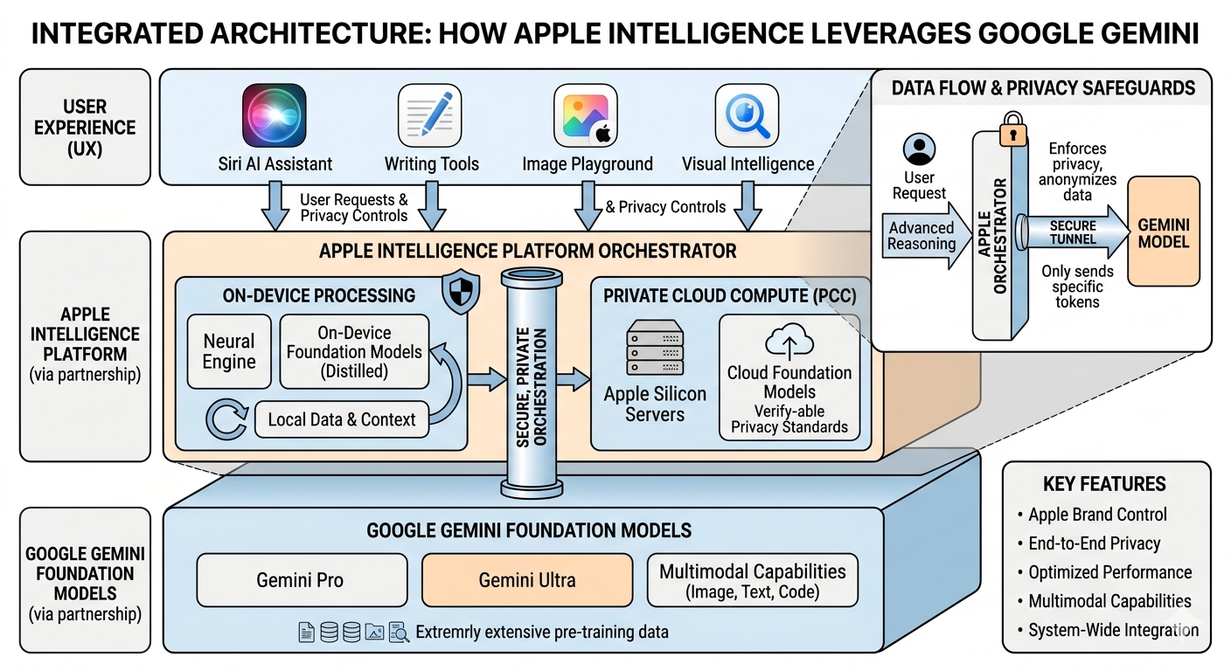

Slide 8



APPLE INTELLIGENCE
Generative features, now across the system
Image Playground 2
Rebuilt search
Make images in almost any style — including far more realistic ones — at virtually any size, across nearly all apps.
Spotlight, Mail & Photos sit on a re-engineered search foundation that's faster and more reliable.
Smarter Home
Built into your apps
The Home app delivers more intelligent security-camera notifications and alerts.
New AI capabilities surface in Photos, Camera, Wallet and more.
SMMUG · WWDC 2026 Keynote Recap · June 8, 2026
7

Slide 9
IOS 27
A more refined Liquid Glass
iOS 27 polishes last year's Liquid Glass look and leans hard into responsiveness. You now control how much of the frosted-glass effect you see, and app icons gain an almost-3D layered depth.
New global slider to dial Liquid Glass intensity up or down
Layered, near-3D effect makes app icons pop
Smoother animations and snappier system-wide responsiveness
Standalone Siri app arrives on iPhone
More accessibility: VoiceOver, Magnifier, natural-language Voice Control
Performance you can feel
30% faster app launches
70% faster photo library
80% faster AirDrop
5x faster external storage
SMMUG · WWDC 2026 Keynote Recap · June 8, 2026
8

Slide 10


IOS 27
Everyday upgrades worth knowing
Health gets deeper
Faster everything
Cycle tracking now covers menopause & perimenopause; rumored nutrition-label scanning feeds data straight into Health.
Re-tuned animations plus the speed gains: apps, photos, AirDrop and file transfers all noticeably quicker.
AI in your apps
Siri, front & center
Image Playground, writing tools and generative features show up across Photos, Camera, Messages and Wallet.
The new standalone Siri app lets you type or talk, with history that follows you across devices.
SMMUG · WWDC 2026 Keynote Recap · June 8, 2026
9

Slide 11

IPADOS 27
iPad keeps pace with iPhone
iPadOS 27 mirrors the iPhone's headline additions — the refined Liquid Glass look, the standalone Siri app, and the same wave of Apple Intelligence features — while pushing further on accessibility.
New Siri app
Apple Intelligence
Accessibility leaps
Type or talk to Siri in its own app, with synced conversation history.
Generative features for Photos, Camera, Wallet and more come to iPad.
Upgraded VoiceOver and Magnifier, plus natural-language Voice Control and more video subtitles.
SMMUG · WWDC 2026 Keynote Recap · June 8, 2026
10

Slide 12
MACOS 27 · GOLDEN GATE
The Mac finally gets the new Siri
Named for the iconic bridge, macOS Golden Gate brings the Gemini-powered Siri to the desktop, extends Liquid Glass across the system, and tightens family controls — but it also draws a hard line on older hardware.
Siri AI on the Mac
More Liquid Glass
Apple silicon only
Voice or text commands that write emails, act on screen content and complete multi-step tasks.
The refreshed design language and standalone Siri app come to macOS.
Intel-based Macs are no longer supported — macOS 27 requires an Apple-silicon chip.
SMMUG · WWDC 2026 Keynote Recap · June 8, 2026
11

Slide 13

MACOS 27 · GOLDEN GATE
Family controls and the end of Intel
Stronger parental controls
Intel Macs left behind
Parents can block specific apps, and new tools automatically filter unsuitable images — including nudity and gore.
Only Apple-silicon Macs can install Golden Gate, closing the book on the Intel transition that began in 2020.
SMMUG takeaway
If any of our members are still on an Intel Mac, this is the release where they get stranded on macOS 26. Worth checking your chip before upgrading — and a good reason to plan a hardware refresh.
SMMUG · WWDC 2026 Keynote Recap · June 8, 2026
12

Slide 14


TVOS 27
Quietly useful upgrades for Apple TV
Redesigned Podcasts
On-device AI subtitles
Readable text
A reworked Podcasts app headlines the Apple TV update.
Generate subtitles for videos locally, right on the Apple TV.
New on-screen text-size adjustment for better legibility from the couch.
A lighter release than the others — but on-device AI subtitles are a genuinely handy accessibility win.
SMMUG · WWDC 2026 Keynote Recap · June 8, 2026
13

Slide 15
WATCHOS 27
AI on your wrist
Siri AI app
Workout insights
Workout Buddy en Español
The new Siri experience comes to Apple Watch.
Smarter analysis of your workout data over time.
The motivational Workout Buddy adds Spanish support.
Heads-up: watchOS 27's compatibility list drops several older Apple Watch models — check before updating.
SMMUG · WWDC 2026 Keynote Recap · June 8, 2026
14

Slide 16

VISIONOS 27
Vision Pro: smaller release, big accessibility
visionOS 27 is a quieter update, mainly tracking the Liquid Glass refinements seen elsewhere — but it lands one standout accessibility feature.
Wheelchair control by eye
Interface refinements
A new Wheelchair Control feature uses Vision Pro's eye-tracking to operate a powered wheelchair — a powerful demonstration of hands-free, gaze-driven control.
Expect the same Liquid Glass polish applied across the lineup, keeping Vision Pro visually consistent with iPhone, iPad and Mac.
SMMUG · WWDC 2026 Keynote Recap · June 8, 2026
15

Slide 17
ONE MORE THING
homeOS — a preview of Apple's smart-home future
Apple gave developers a formal preview of homeOS, a new platform purpose-built for upcoming smart-home hardware. The software is arriving ahead of the device so developers can build apps in advance.
Developer preview only — not shipping to users yet
Built for the rumored “HomePad”: a HomePod with a 7” display
Reportedly runs an A18 chip as a smart-home hub
Hardware expected to launch in autumn
Software first, hardware later
Releasing the platform early echoes how Apple seeded the Watch and Vision Pro ecosystems before launch day.
SMMUG · WWDC 2026 Keynote Recap · June 8, 2026
16

Slide 18



THE FINE PRINT
Big asterisk: Siri AI skips the EU at launch
The most consequential caveat: the new Siri AI will not be available in the European Union on iOS 27 and iPadOS 27 — at least not initially. Apple continues to cite regulatory friction under the Digital Markets Act.
EU left waiting
Regulatory friction
US unaffected
The flagship Siri experience is excluded from EU iPhones and iPads at launch.
Apple points to DMA compliance as the reason for the staggered rollout.
For SMMUG members in the US, Siri AI ships on the normal timeline.
SMMUG · WWDC 2026 Keynote Recap · June 8, 2026
17

Slide 19

WILL MY DEVICE RUN IT?
Compatibility — the cutoffs that matter
Siri AI / Apple Intelligence
macOS Golden Gate
Requires iPhone 15 Pro or newer. Older iPhones get iOS 27, but not the full AI features.
Apple-silicon Macs only. All Intel Macs are dropped this cycle.
iPhone cut line
Apple Watch
Reports indicate the iPhone 11 is among models losing iOS 27 support.
watchOS 27 drops several older models — verify yours before updating.
SMMUG · WWDC 2026 Keynote Recap · June 8, 2026
18

Slide 20
WHEN DOES IT SHIP?
The rollout timeline
Jun 8
July
Sept
Fall
Developer betas
Public betas
General release
Siri AI stable
iOS 27 & all six OSes seed to developers right after today's keynote.
Free public betas open up; Siri AI beta expected this month too.
Final versions ship to everyone — alongside the iPhone 18 lineup.
The fully rebuilt Siri reaches its stable release; homeOS hardware expected.
SMMUG · WWDC 2026 Keynote Recap · June 8, 2026
19

Slide 21
WHAT THE ANALYSTS SAY
Reading between the lines
Mark Gurman · Bloomberg
Gene Munster · Deepwater
The consensus read
Reported the Gemini deal and the July-beta / September-release cadence well ahead of the keynote — and called the EU exclusion.
Pegs the multi-year Google deal at up to ~$5B and sees the Gemini move as Apple buying time to catch up.
Leaning on Google is pragmatic but risky — it puts Apple's marquee feature on a rival's model and invites antitrust scrutiny.
Bottom line: the timing analysts predicted held up. Watch the July public beta as the real test of whether the new Siri delivers.
SMMUG · WWDC 2026 Keynote Recap · June 8, 2026
20

Slide 22

STILL UNANSWERED
Rumors & open questions to watch
How good is it, really?
Privacy in practice
Demos impress, but the last Siri overhaul slipped. The July beta will show if it lives up to the keynote.
Apple says Google never sees your data via Private Cloud Compute — independent scrutiny will follow.
When does the EU get Siri AI?
Where's the HomePad?
No firm date. A 2027 arrival is plausible if DMA issues drag on.
homeOS is here; the hardware isn't. An autumn reveal is rumored but unconfirmed.
SMMUG · WWDC 2026 Keynote Recap · June 8, 2026
21

Slide 23
FOR SMMUG MEMBERS
What this means for us
Don't rush the beta. Public betas land in July, but wait for September if your iPhone is your daily driver.
Check your hardware. Intel Mac owners stop at macOS 26; the new Siri needs iPhone 15 Pro or newer.
Verify your Apple Watch. watchOS 27 drops several older models from the compatibility list.
The headline feature is Siri AI — and it's powered by Google Gemini, a genuine first for Apple.
US members get Siri AI on schedule; the EU is waiting. Good news for our group.
Back up before you update. As always, a current backup beats a fast upgrade.
SMMUG · WWDC 2026 Keynote Recap · June 8, 2026
22

Slide 24


WANT TO TRY IT EARLY?
Getting on the beta — safely
Public beta in July
Back up first
Use a spare device
Enroll free at beta.apple.com. Developer betas are out now but meant for developers.
Make a full backup (and ideally an archived one) before installing any beta.
Betas can be buggy. Avoid installing on the iPhone or Mac you rely on daily.
We can do a hands-on beta walkthrough at a future SMMUG meeting once the public beta is stable.
SMMUG · WWDC 2026 Keynote Recap · June 8, 2026
23

Slide 25
Questions?
Thanks for coming, SMMUG. Let's talk about what excites — or worries — you about Apple's AI year.
One of the oldest Mac user groups in the country — still going strong.
SMMUG · WWDC 2026 Keynote Recap · June 8, 2026
24

Slide 26
SOURCES
Where this came from
Bloomberg (Mark Gurman) — WWDC 2026 preview & Gemini-Siri deal reporting
Engadget — “Everything announced at Apple's WWDC 2026 keynote”
TechRadar — WWDC 2026 live coverage & macOS Golden Gate explainer
Tom's Guide — iOS 27 official feature roundup
AppleInsider — iOS 27 & macOS 27 “Golden Gate” hands-on reports
MacRumors — WWDC 2026 what-to-expect & developer beta release
Wareable — watchOS 27 features & compatibility
Fox Business / IndexBox — Tim Cook's farewell keynote coverage
CNBC, TechCrunch, Creative Bloq — additional keynote analysis
Compiled June 8, 2026. Figures (model size, deal value, dates) are as reported by the press and may be refined as Apple confirms details.
SMMUG · WWDC 2026 Keynote Recap · June 8, 2026
25

